Slide 1


Slide 2

01
Flutter
Tensorflow

Slide 3
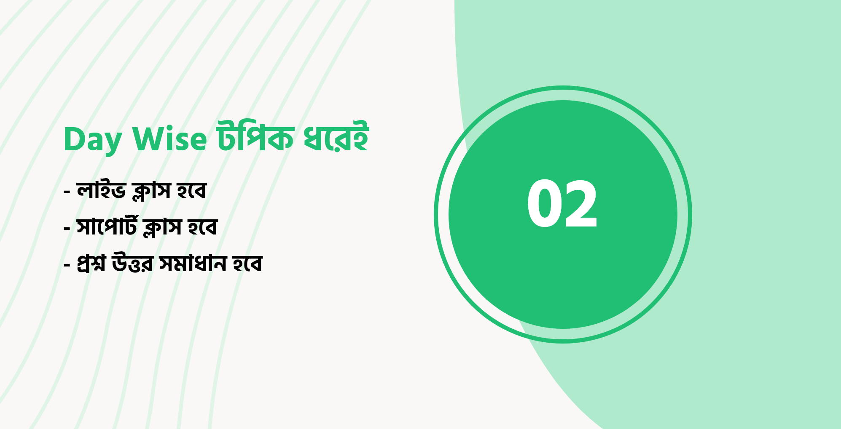
01
Flutter
Tensorflow

Slide 4

01
Flutter
Tensorflow

Slide 5

01
Flutter
Tensorflow

Slide 6
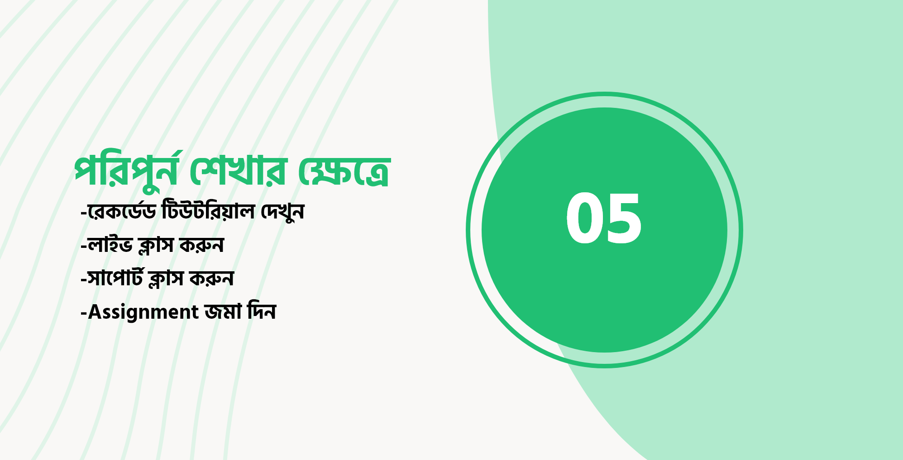
01
Flutter
Tensorflow

Slide 7

01
Flutter
Tensorflow

Slide 8

01
Flutter
Tensorflow

Slide 9

01
Flutter
Tensorflow

Slide 10
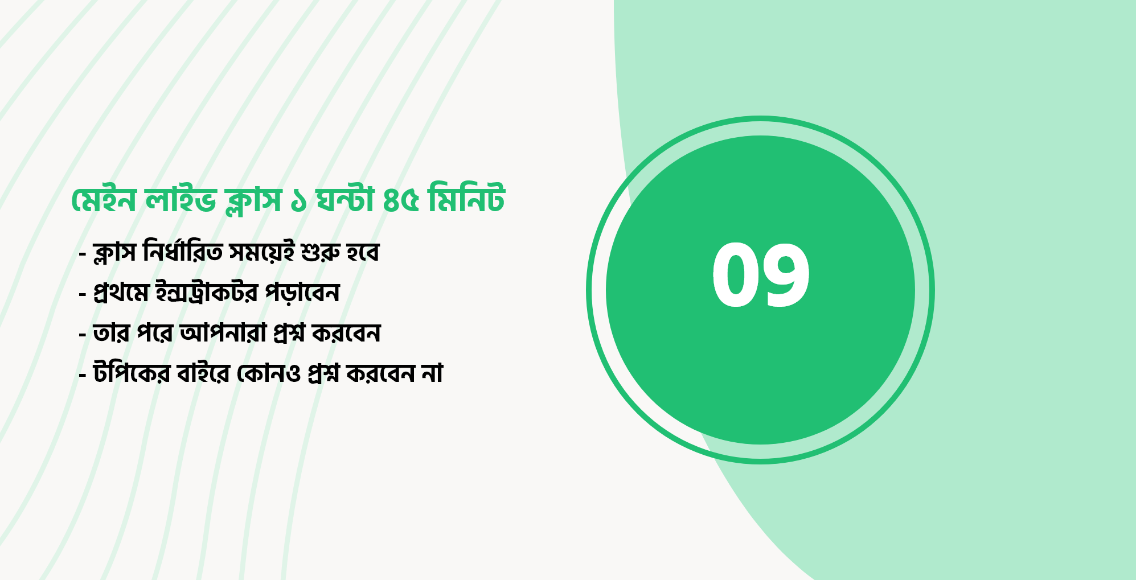
01
Flutter
Tensorflow

